Slide 1
ROSETTA FlexPepDock Tutorial
Nawsad Alam, Ora Schueler-Furman
The Hebrew University of Jerusalem

Slide 2
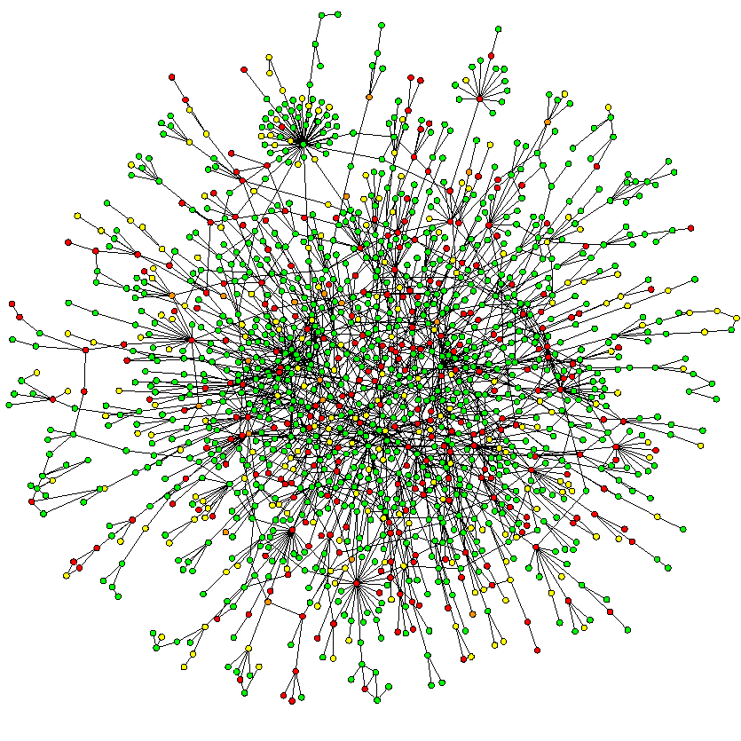
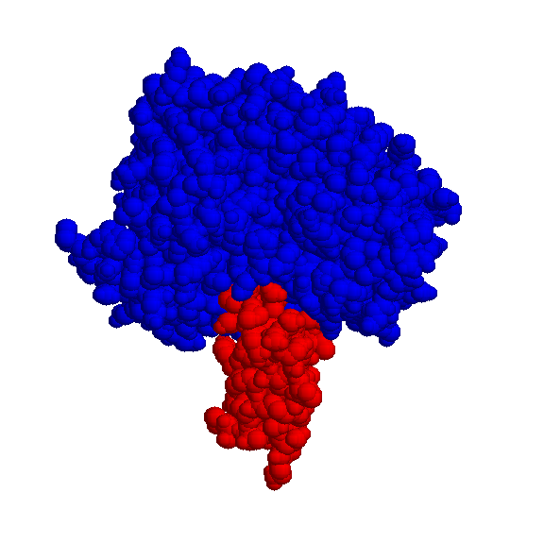
“Tell me with whom you go,
and I'll tell you what you are.” Italian Proverb
+
Interaction Function
Structure Interaction
High-resolution modeling of
structure & specificity
of protein – peptide interactions
High-resolution modeling of
structure & specificity
of protein – protein interactions
“Tell me how you contact your partners,
and I'll tell you who you are.”

Slide 3
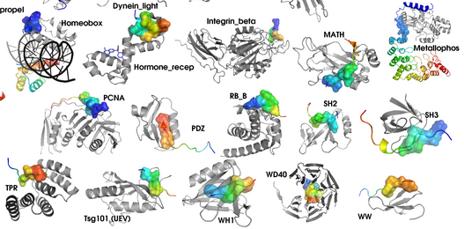
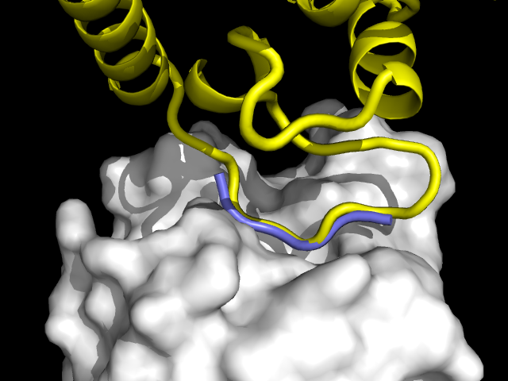
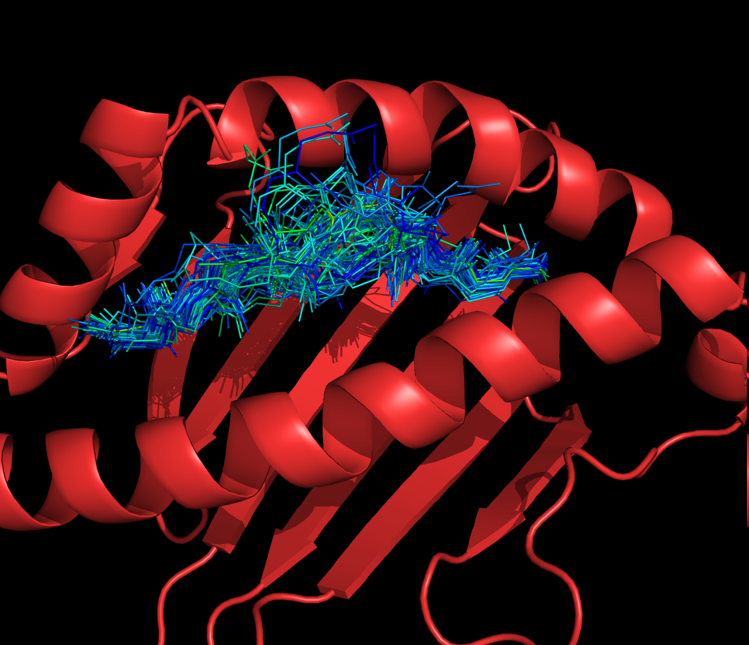
Peptide-mediated PPI’s come in flavors
1. Linear motifs within unstructured regions (signaling; modification)
2. Continuous stretch at PPI interface
main contribution to binding
similar structure as free peptide
3. Free peptide
Aloy et al. Plos ONE (2008)
proline isomerase –
HIV capsid protein (HAGPIA peptide)
MHC-peptide complex

Slide 4
… but there is actually more to it ….
Peptides can indeed enhance communication!

Slide 5
What we will talk about today …
Short introduction to Rosetta
Features of peptide-protein interactions
Peptide-protein docking using Rosetta FlexPepDock

Slide 6
What we will talk about today …
…. and do:
Run FlexPepDock refinement on server (easy)
Run prediction yourself ☺
Run ab initio FlexPepDock
Predict binding partners using Rosetta FlexPepBind
+

Slide 7
The basic assumption in structure prediction
Native structure located in global minimum (free) energy conformation (GMEC)
A good energy function can select the correct model among deco
A good sampling technique can find the GMEC in the rugged landscape
GMEC
E
Conformation space

Slide 8
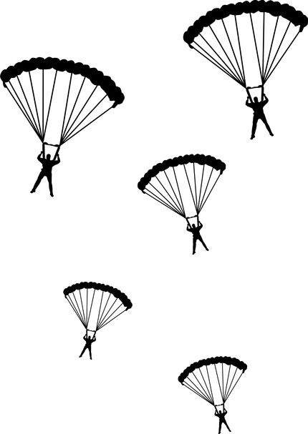
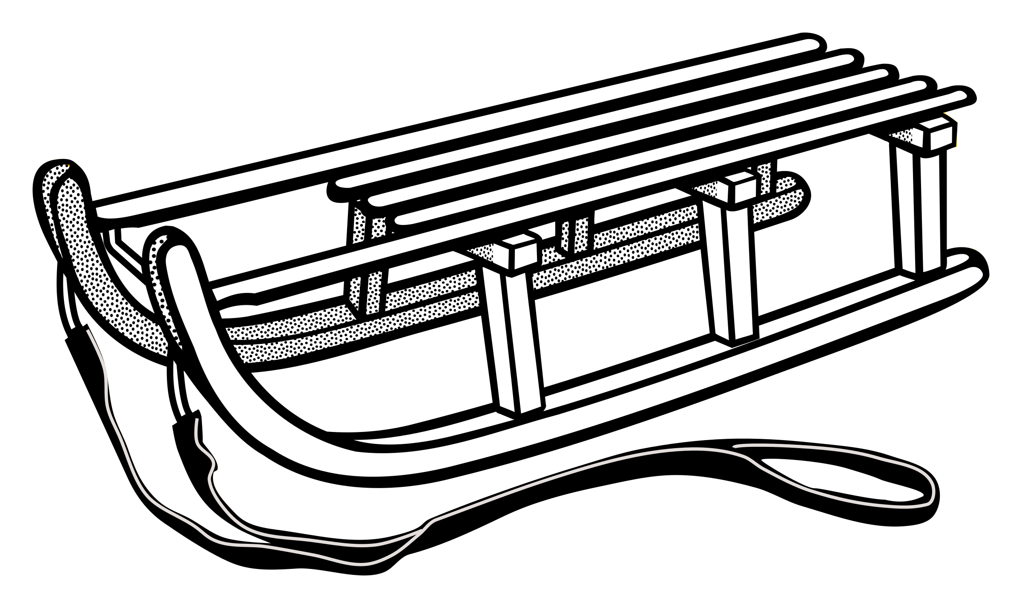
How would you search for, and find, the Global Minimum on Earth?
Small pits and the Sea of Galilee are local minima
Rough energy landscape
Rough task!
*Adapted from slide by Chen Kaeasar, Ben-Gurion University

Slide 9
Fold tree representation
Combine different degrees of freedom to sample/minimize
Fold-tree based docking
“peptide” edge – 3 backbone dihedral angles
1
2
3
4
5
6
7
8
“long-range” edge – 6 rigid-body DOFs
1’
2’
3’
4’
5’
6’
7’
8’
1’
2’
3’
4’
5’
6’
7’
8’
“peptide” edge – 3 backbone dihedral angles
Construct fold-trees to treat a variety of protein folding and docking problems
Fold tree: Bradley and Baker, Proteins (2006)

Slide 10
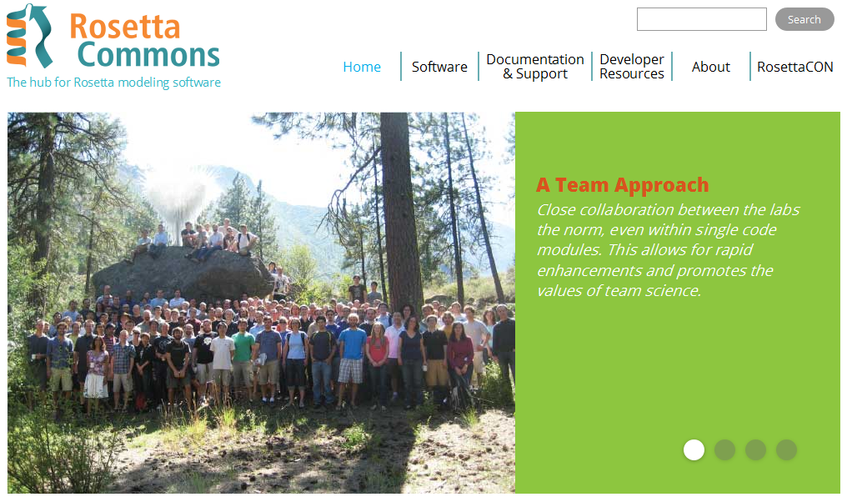
The ROSETTA Strategy for structure prediction and design
www.rosettacommons.org

Slide 11
Don’t get stuck! Trick 1:
Monte Carlo with Minimization MCM
rigid body optimization
backbone optimization
Side chain optimization
Random
perturbation
Random perturbation
Side chain
optimization
Rigid body/backbone minimization
Rigid body/backbone
minimization
START
MC
Energy
FINISH
Rigid body orientations/ backbone conformations
Notes:
In the high-resolution refinement step the side chain atoms are added back.
Side chains are selected from a rotamer library that contains a discrete set of likely conformations.
A full atom energy function calibrated on different Rosetta protocols is now used to evaluate and optimize models. It contains mainly van der waals attractive and repulsive terms, and in addition accounts for solvation and hydrogen bonding.
We then use monte-carlo with minimization, in short MCM, to search the minimum energy conformation in the vast space of possible configurations.
HANDS Let’s try to find the nearby optimum of a given RB orientation. For this we make a small change in the RB orientation. This might lead to clashes. Rearrangement of the side chains at the interface can sometimes relieve those clashes. Only then we further optimize the RB orientation. This mimics conformational changes upon binding at the side chain level. At the end of such a step, we evaluate whether a better conformation has been obtained.
Let’s look at how the monte-carlo cycle that I just described looks on the energy landscape:
Each of the possible rigid body orientations of the two monomers can be characterized by its energy, and its distance to some arbitrary reference.
Each monte carlo cycle starts with a small change of the protein’s relative orientation in our search for the minimum.
Instead of minimizing the RB orientation directly however, we first allow the monomer conformation to adapt to the new orientation, by optimizing the side chain conformations. This allows to relieve a clash that involves the side chains at the interface. This of course also changes the energy landscape: The energy of a given RB orientation is changed if the monomer conformations are different.
We now optimize the rb orientation by deepest descent minimization. This locates a minimum that might not have been apparent in the previous landscape.
Finally, we apply the MC criterion, accepting in addition to downward moves also moves that increase the energy, by a boltzman-dependent probability.
Repeated cycles of this procedure allow us to efficiently find the minimum energy conformation near the starting point.

Slide 12
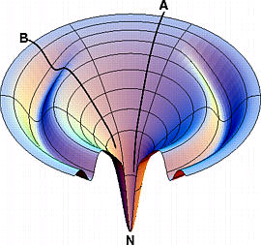
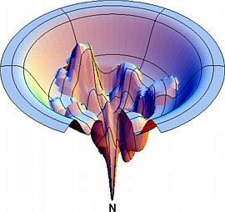
Don’t get stuck! Trick 2: Switch smooth and rugged energy functions
In Rosetta, the Centroid energy function is used to quickly sample large perturbations
The Full-Atom energy function is used for fine tuning
START
Smooth Low-res
Rugged High-res
energy
conformations

Slide 13
Smooth: Low-Resolution Step
Structure Representation:
Equilibrium bonds and angles (Engh & Huber 1991)
Centroid: average location of center of mass of side-chain
(Centroid | aa, φ,ψ)
No modeling of side chains
Fast

Slide 14
Low-resolution parameters
S_{env} - burial preference (number of neighbors)
S_{pair} - preferred amino acid pairs (e.g. cys-cys, glu-arg, etc)
S_{ss} + S_{HS} - sheet and helix-sheet geometries
compactness of structure
S_{cβ}
S_{vdw} no clashes
S_{rgyr} globular structure
small vs. large
radius of gyration (R_{gyr})

Slide 15
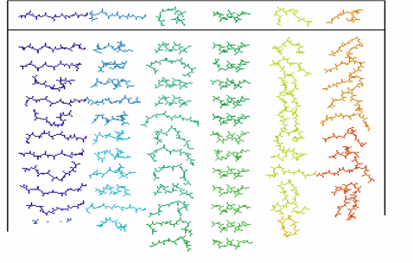
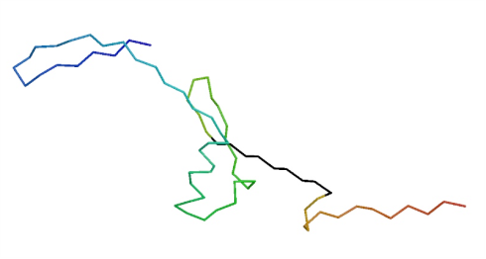
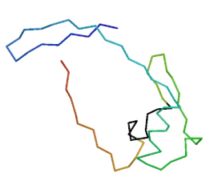
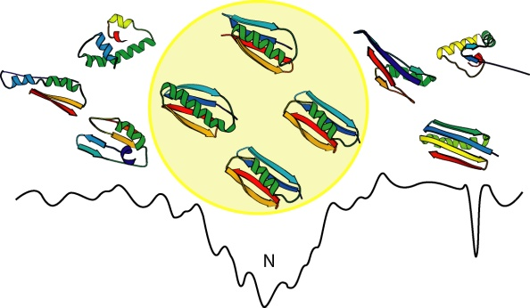
Basic Ab Initio Rosetta protocol
Select fragments consistent with local sequence preferences
Assemble fragments into models with native-like global properties
Identify the best model from the population of decoys
Figures adapted from Charlie Strauss;
Protein structure prediction using ROSETTA
Rohl et al (2004) Methods in Enzymology, 383:66

Slide 16
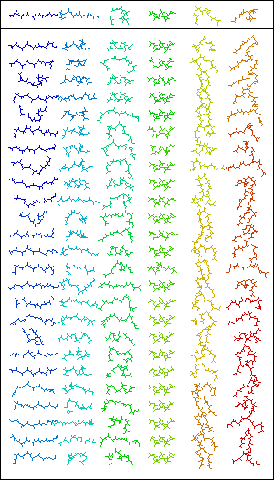
Select fragments: local sampling
C
Fragment libraries
Selected from PDB
Ranked by sequence similarity and similarity of predicted and known secondary str.
Discard improbable conformations

Slide 17
Assemble fragments into compact structure
Fragment exchange
Local moves
Initial global changes
Further refinement
Movie by Jens Meiler

Slide 18
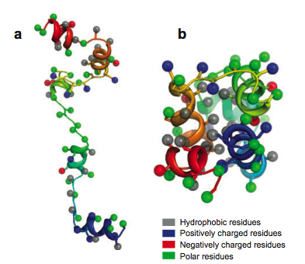
Smooth: Low-Resolution Step

Slide 19
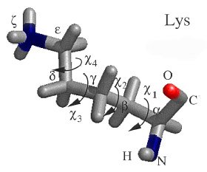
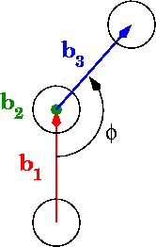
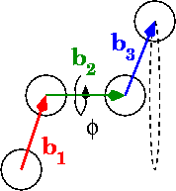
Rough - High-Resolution Step
Slow, exact step
Locates global energy minimum
Structure representation:
All-atom (no water)
Side chains as rotamers from backbone-dependent library
Side chain conformation adjusted frequently
START
energy
conformations
From wikipedia

Slide 20
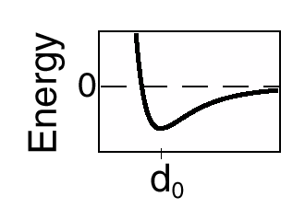
High-resolution step: parameters
VdW
12-6 Lennard Jones
linear repulsion
Cutoff within 5.0-5.5Å
Solvation (Lazaridis-Karplus)
Hydrogen bonds
r_{ij}
+
Weak pair potential
Electrostatic interactions
π−π, π-+
Backbone torsions (rama score)
-
polar
polar
d
O
C
H
Ψ
N
Θ

Slide 21
Final structure – optimum in energy landscape
Major contributions:
Burial of hydrophobic groups
Void-free packing of buried groups and atoms
Buried polar atoms form intra-molecular hydrogen bonds

Slide 22
The Rosetta sampling strategy: Summary
Fragment Sampling
9 residue fragments
3 residue fragments
Gradual addition of parameters to scoring function
Quick quenching
Local optimization
Strategies to keep fragment insertion/perturbation local
Monte Carlo (MC) Sampling
MC sampling with minimization
Side chain rearrangement
Repacking and refinement

Slide 23
Protein design
Structure prediction and design are inverse problems

Slide 24
ROSETTA FlexPepDock
(now that you know everything about Rosetta…)
+

Slide 25
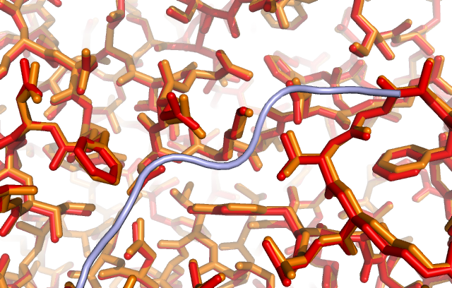
The challenge in peptide docking
The challenge
Considerable flexibility of peptide
Many degrees of freedom need to be optimized .. simultaneously
The discount
Receptor is pre-arranged
>80% of complexes
<1-2 Å RMSD
based on curated dataset of peptide-protein complex structures
+
+
London, Movshovitz-Attias & Schueler-Furman. Structure (2010)

Slide 26
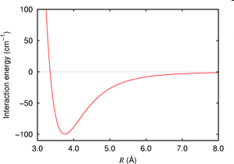
FlexPepDock uses Rosetta infrastructure for structural modeling
Energy function (full-atom/centroid side-chains)
Sampling and optimization
“Monte-Carlo search with energy Minimization” MCM (Liu et al.)
FlexPepDock protocol for flexible peptide docking and redesign
random
perturbation
repack
Loop modeling
START
Fragment libraries
energy
minimization
conformations
FINISH
Raveh, London et al. Proteins (2010)

Slide 27
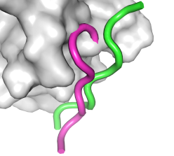
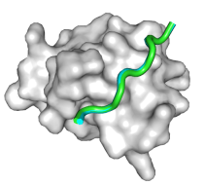
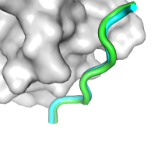
Outline of Rosetta FlexPepDock
Input structure
x200
200 Output
models
Side-chain pre-packing
Increasing repulsive term
Decreasing attractive term
X10 outer cycles
Rigid body optimization x8 MCM cycles , side-chain optimization on-the-fly
Peptide backbone optimization x8 MCM cycles, side-chain optimization on-the-fly
Optional low-resolution pre-optimization protocol
Raveh, London et al. Proteins (2010)
Notes:
Figure 1

Slide 28
Scope & quality of Rosetta FlexPepDock
Large effective range
Very accurate
0-1Å
1-2Å
2-3Å
3-4Å
4-5Å
Sub-
Angstrom
Near-
native
Native
Raveh, London et al. Proteins (2010)

Slide 29
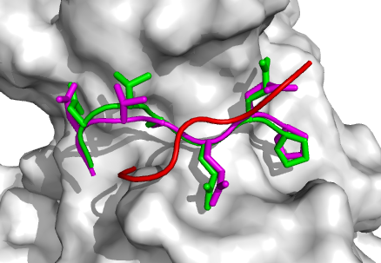
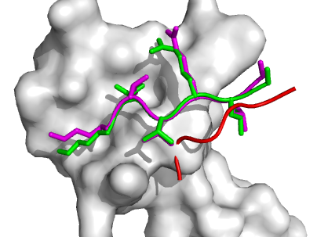
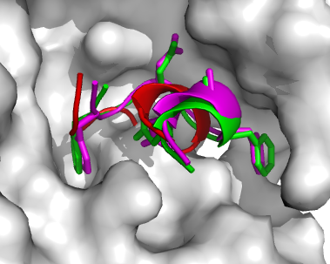
Examples
PDB: 1CZY
TRAF domain – LMP1 binding peptide
PDB: 2DS8
ClpX – SspB tail
PDB: 2IV9
AP2 – EPS15 peptide
native input prediction
Accurate prediction of motif residues
Raveh, London et al. Proteins (2010)

Slide 30
Extension of Rosetta FlexPepDock
DOF
10000-50000 models
10 outer cycles
200 or more models
attractive term
repulsive term
rigid body moves (Monte-Carlo with Minimization)
backbone ‘small’ and ‘shear’ moves (Monte-Carlo with Minimization)
FlexPepDock
http://flexpepdock.furmanlab.cs.huji.ac.il
Simulation temperature
rigid body moves
(Monte-Carlo)
backbone moves : fragment insertion + random moves (Monte-Carlo)
Ab initio FlexPepDock
Full ab initio

Slide 31
ROSETTA FlexPepBind

Slide 32
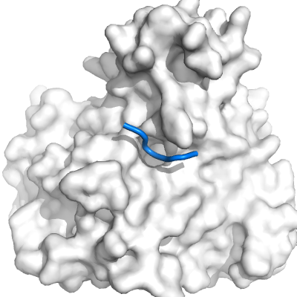
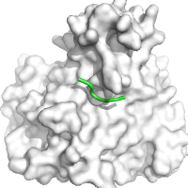
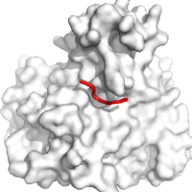
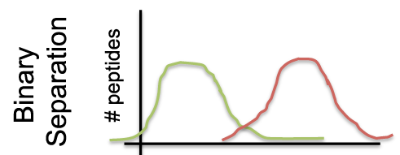
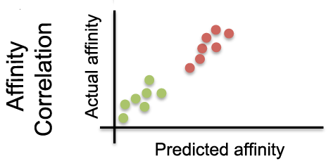
FlexPepBind Framework
INPUT
peptide-protein complex structure
training set
Binders Non-Binders
GYKacFGC GWKacMGC
GIKacWGC GMKacGGC
GRKacFGC GKKacKGC
CALIBRATION
model set
adjust protocol
optimize for:
PREDICTION
large-scale application
RESULTS
identify new protein targets from discovered peptide substrates
...ERFEMFRELNEALELKDAQAGKEPGGSRAHSSHLKSKKGQSTSRHKKLMFKTEGP...
1
2
3
.
.
.
.
.
.
+
.
.
.
.
.
.
Alam et al. , Structure 2016
Notes:
*Once we are done with calibration we can use it to predict new substrates.

Slide 33
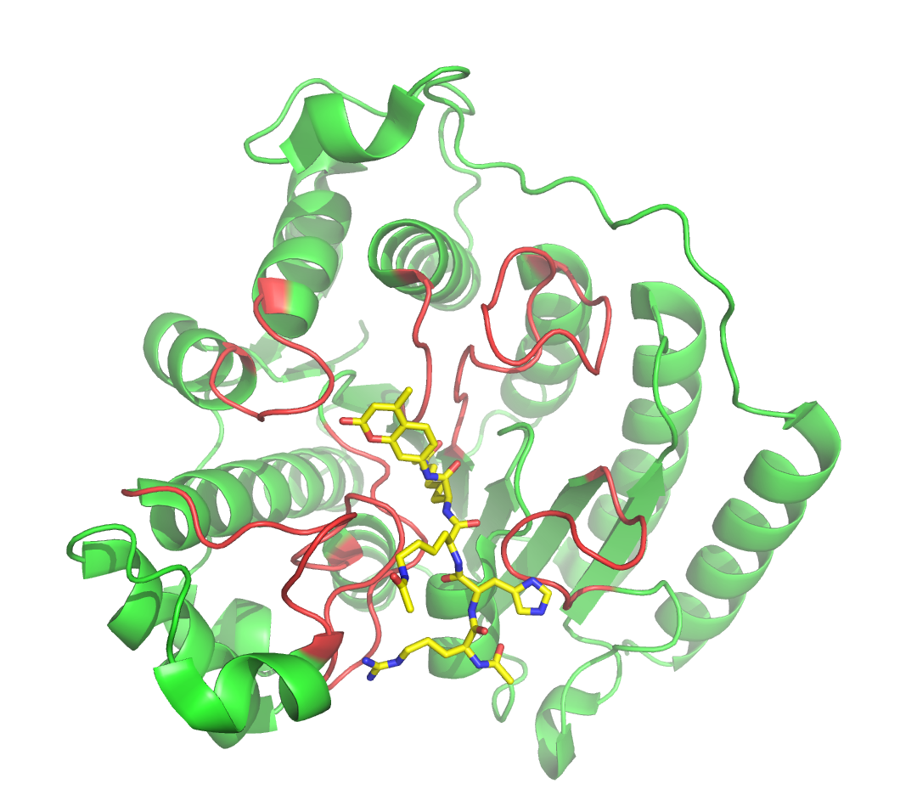
Alam et al. , Structure 2016

Slide 34
Towards global peptide docking
Combine FlexPepDock with Solvent mapping

Slide 35
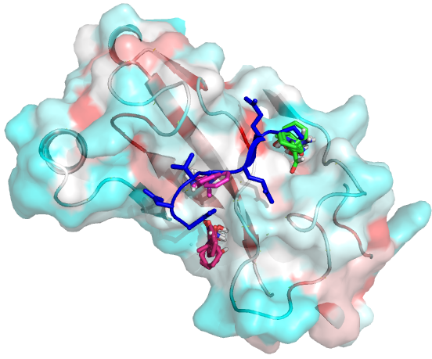
Full ab initio FlexPepDock protocol: Peptimap finds peptide binding sites
Peptimap: Computational solvent mapping - finds binding sites
Example: 1ca4 traf2
Rank1
Rank2
Rank3
>3
Try it yourself:
http://peptimap.bu.edu
Raveh, London, Zimmerman & Schueler-Furman. PloS ONE Rosettacon Issue (2011)
Lavi, Ngan, Movshovitz-Attias, Bohnuud, Yueh, Beglov, Schueler-Furman & Kozakov. Proteins (2013)
Notes:
Change frame of right figure; add details slide at the end

Slide 36
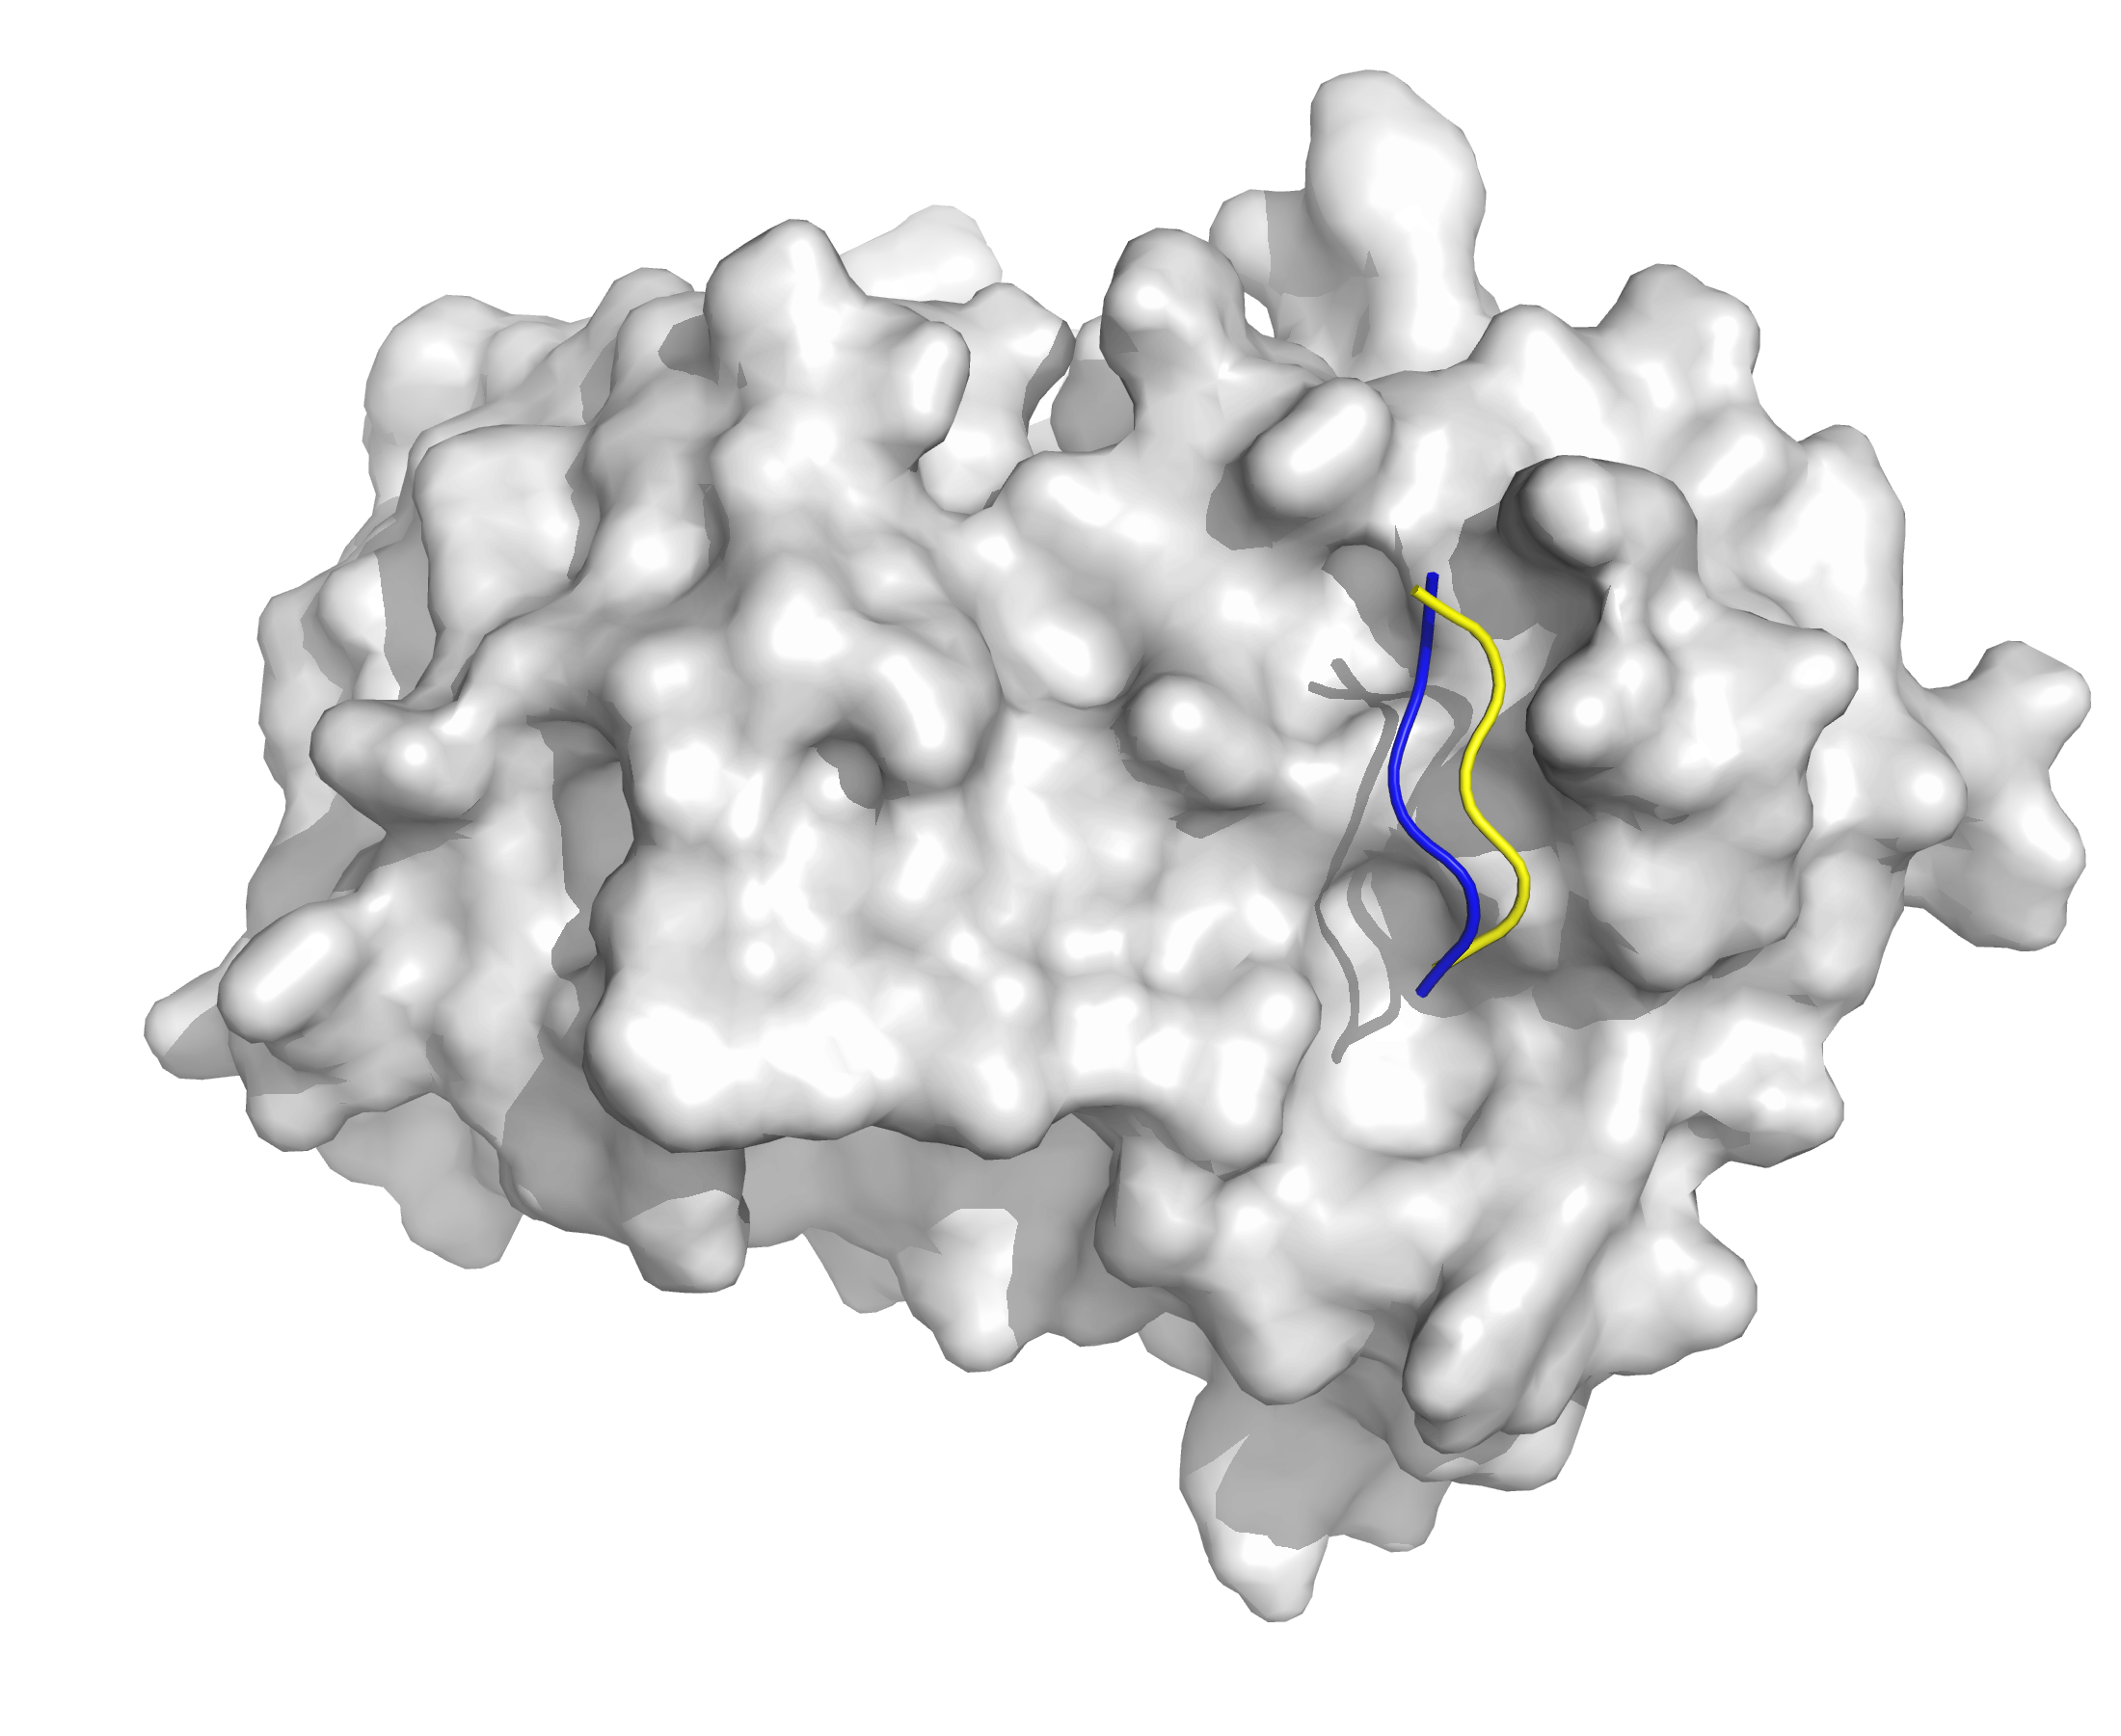
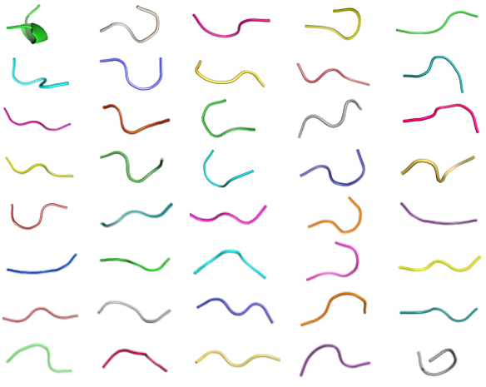
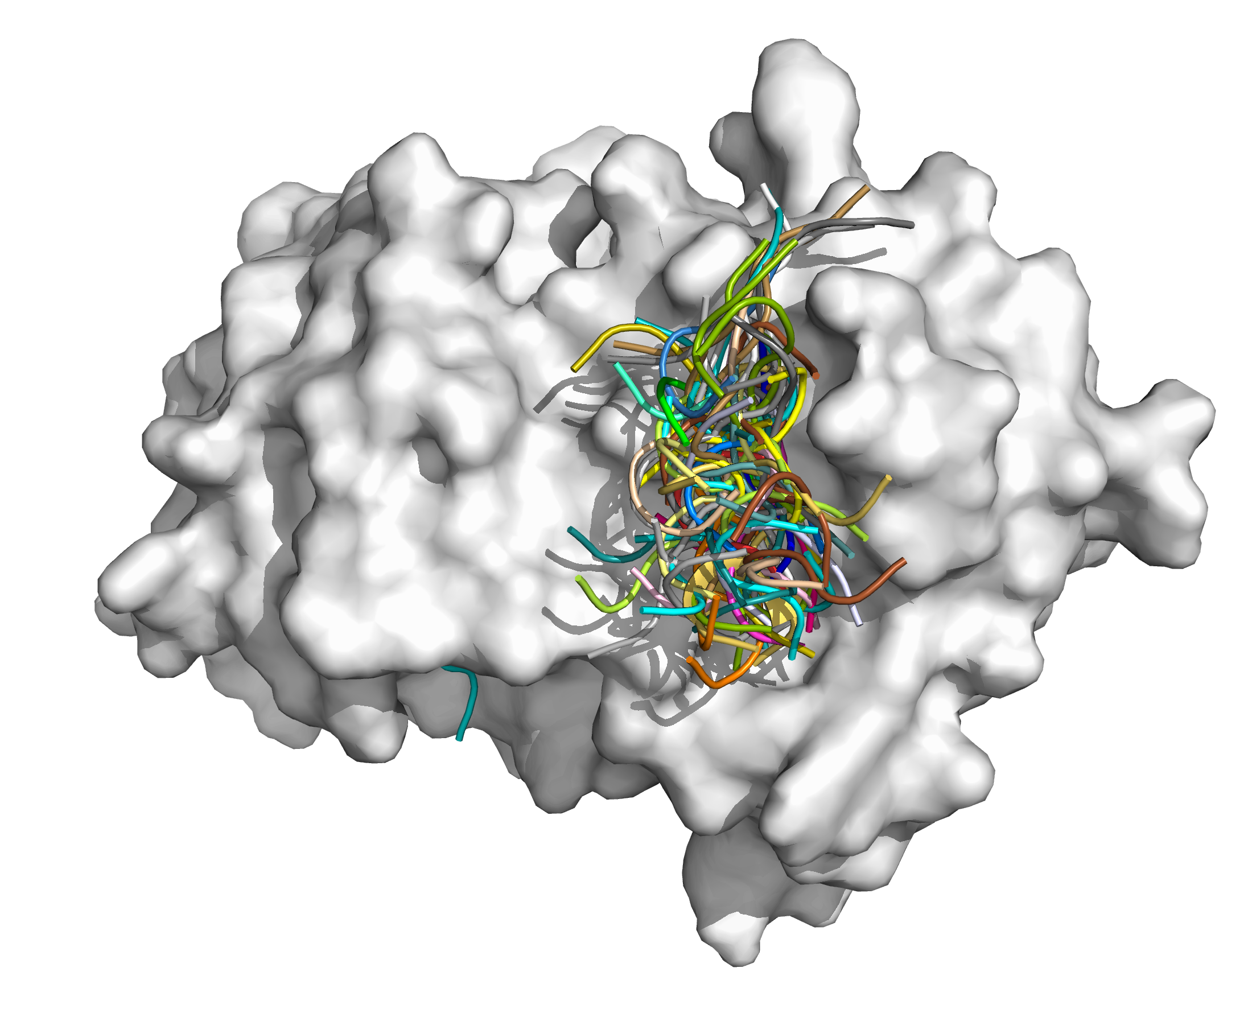
PeptiDock: rigid body motif docking
Initial motif
Motif extension
Cyclin
CDC6
HTLKGRRLVFDN
+
HTLKGRRLVFDN
HTLKGRRLVFDN
HTLKXRRLVFDN
Motif fragment library extraction
Clustering
Clustering
Model selection
Rigid body docking*
* Using PIPER; Kozakov et al. (2013) Proteins 81:2159

Slide 37
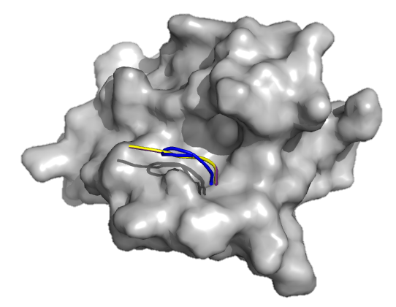
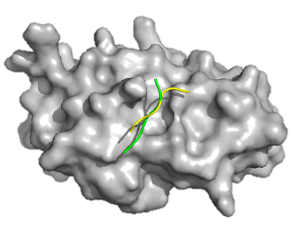
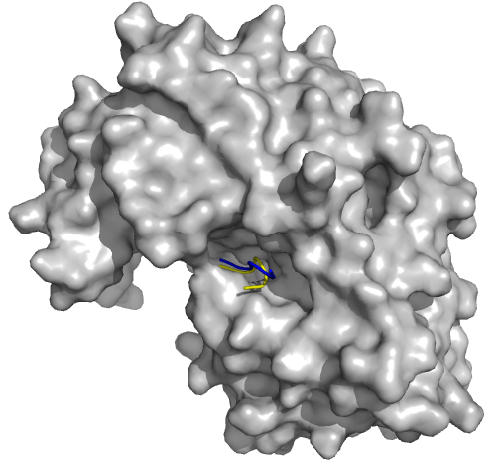
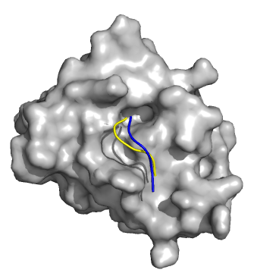
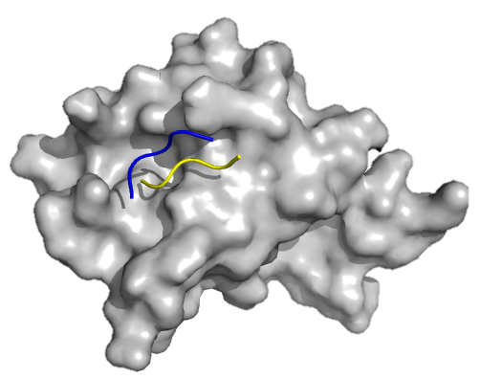
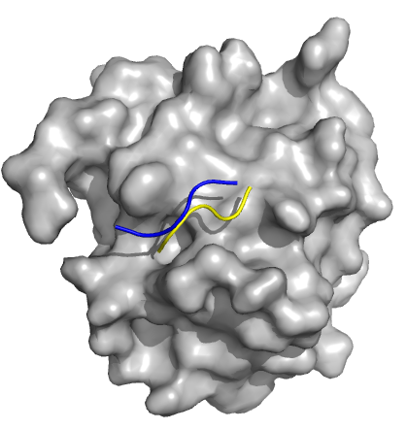
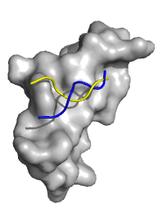
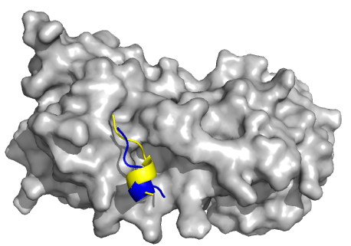
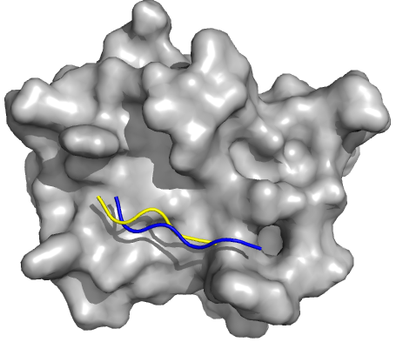
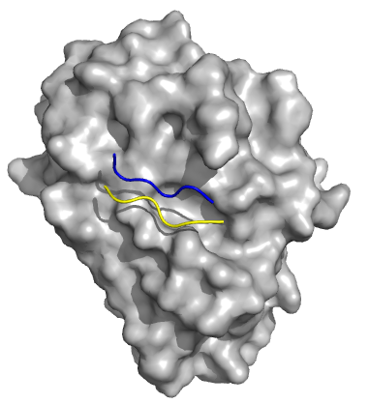
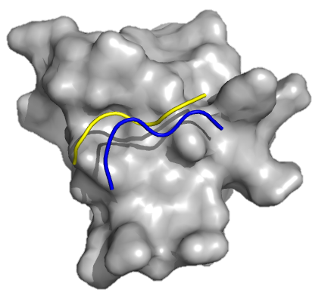
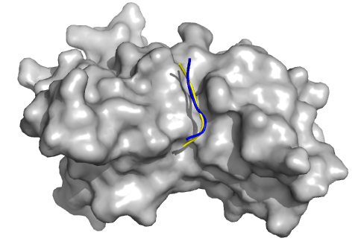
http://cluspro-pep.bu.edu/

Slide 38
Thank you!
From the web…. Elizabeth Arden Cosmetics

Slide 40
Other peptide docking approaches

Slide 41
GalaxyPepDock, Seok group http://galaxy.seoklab.org/cgi-bin/submit.cgi?type=PEPTDOCK
Template-based docking

Slide 42
PEPFOLD 3, Tuffery group http://bioserv.rpbs.univ-paris-diderot.fr/services/PEP-FOLD3/
Folding peptides from fragments,
within the context of a receptor

Slide 43
pepATTRACT, Zacharias group Web interface at www.attract.ph.tum.de/peptide.html
Scripting interface (no server, yet)
Efficient use of reduced atom model for fast search

Slide 44
CABSdock, Kmiecik group http://biocomp.chem.uw.edu.pl/CABSdock/

Slide 45
PepCrawler, Wolfson group http://bioinfo3d.cs.tau.ac.il/PepCrawler/

